Slide 1
User Story Mapping
Caz Farrell & Elly Griffith-Ward

Slide 2

Notes:
Use of laptops and phones

Slide 3
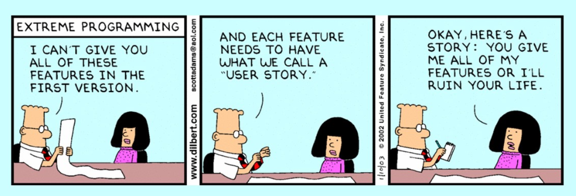
Notes:
Explain where user stories came from
XP
Designed by developers.

Slide 4
User Stories….

Slide 5
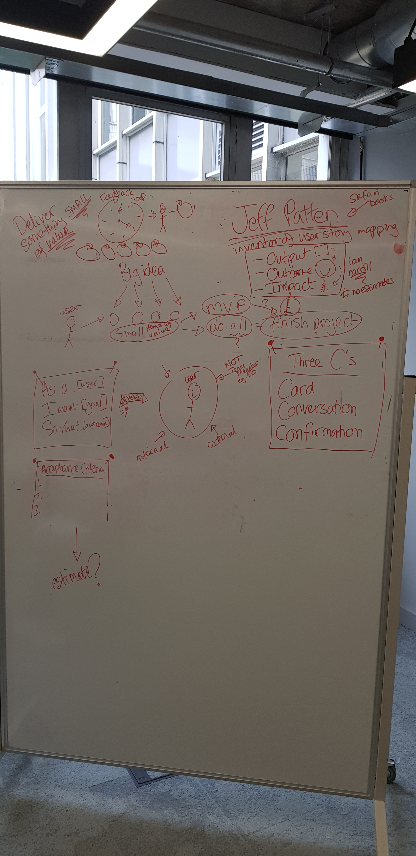
Notes:
Brainstorm what we know about User stories

Slide 6
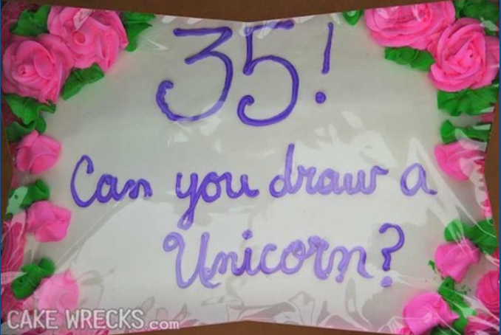
Notes:
Let’s say you own a cake shop.
You get a phone call from a customer. He wants a cake for his daughter.
You write the message down. Your colleague makes the cake…
The goal of using stories isn’t to write better stories.
Shared documents aren’t shared understanding. (Documents include Jira tickets)
Shared understanding is when we both understand what the other person is imagining and why. Obviously, there wasn’t shared understanding between this cake decorator and the person who gave them instructions in writing. In fact, this problem is so common that there's a whole website dedicated to these miscommunications in the cake world called cakewrecks.com

Slide 7
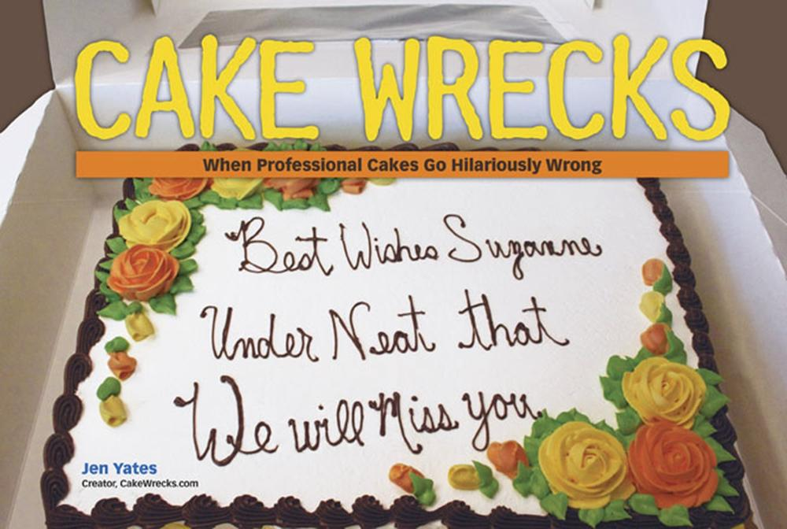

Slide 8
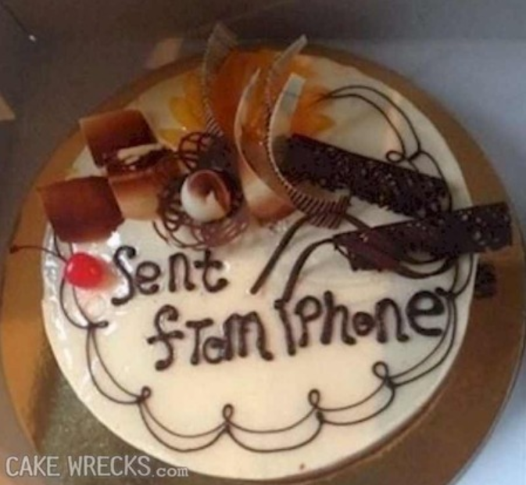

Slide 9
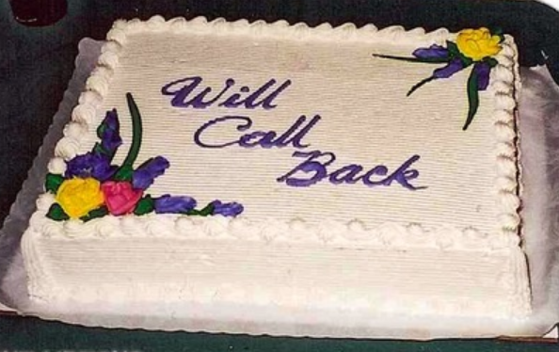

Slide 10
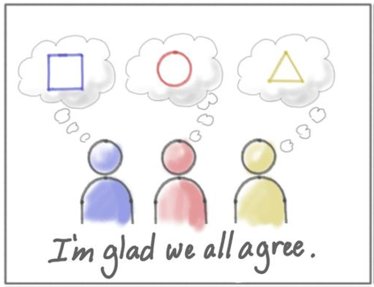
Shared Documents are not shared understanding

Slide 11
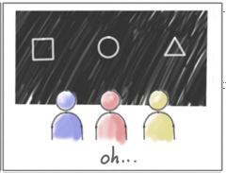

Slide 12
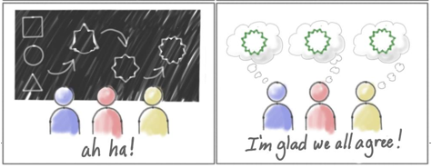
Story Mapping Helps with this…

Slide 13
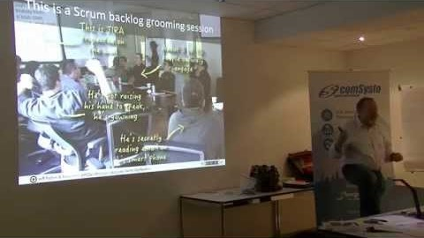

Slide 14
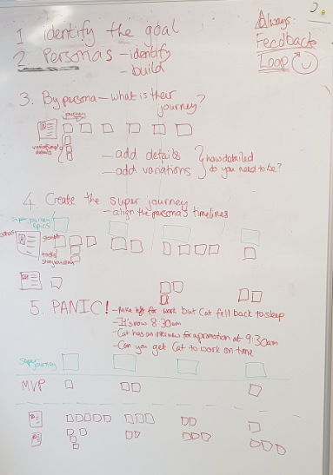

Slide 15
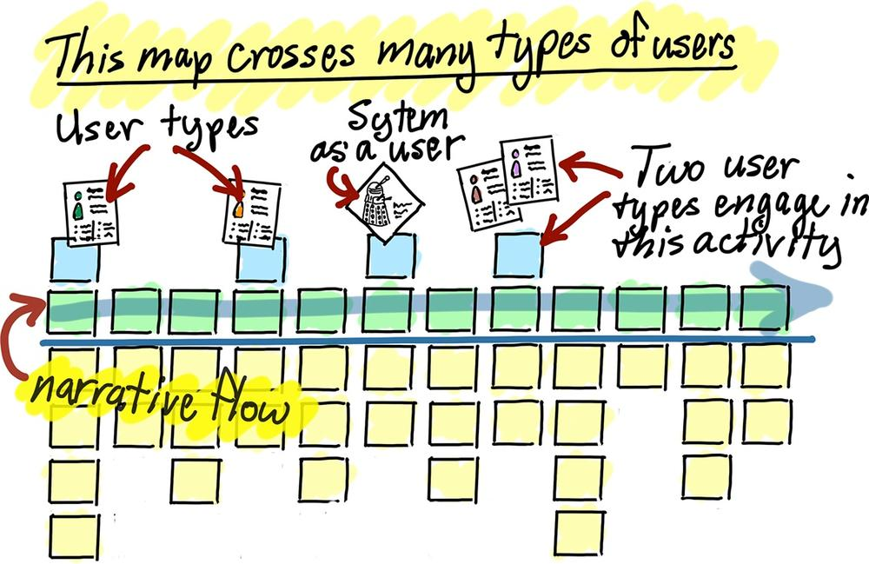

Slide 16
Tomorrow
User Mapping for a real world situation
Further Recommended Reading:
User Story Mapping by Jeff Patton
Sense and Respond by Jeff Gothelf
#noestimates movement

Slide 17
Questions?

Slide 18
Day Two: User Story Mapping Applied
Caz Farrell
Elly Griffith-Ward

Slide 19
Recap….

Slide 20
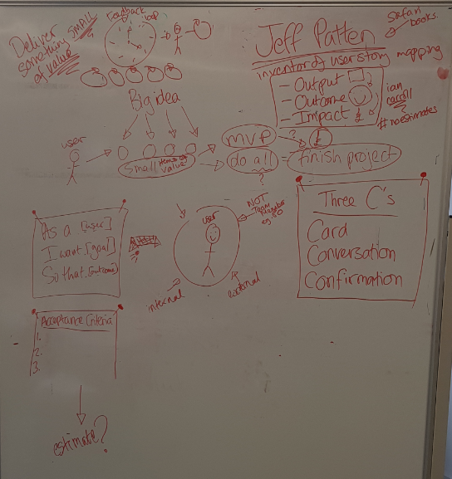

Slide 22
Yesterday………………..allllll my troubles seemed so far away….
GOAL: Get everyone up and where they need to be
Create super journey
Get up
Wash
Make self presentable
Have break fast
Commute
Minimum
Wake up
Get up
Get Caitlin up
Get dressed
Leave House
Do school drop off
Walk to train
Release 2
Shower
Brush teeth
Do make up
Catherine
Wake up
Snooze alarm
Get up
Shower
Brush teeth
Get Caitlin up
Brush & dry hair
Get dressed
Moisturise
Do make up
Leave House
Do school drop off
Walk to train
Work out the absolute minimum
Bath
Chew gum
Leave hair to dry
Users
Add the next THIN slice
Build the story for each user
Have a babywipe wash
Consider alternatives
Mike
Get up
Get dressed
Feed Dogs
Walk dogs
Shower
Gel hair
Brush teeth
Have breakfast
Drive to work
Et voila…
We have v 1 of our user story map
Caitlin
Wake up
Refuse to move
Argue with mum
Go to toilet
Brush teeth
Get dressed
Grab apple
Walk to breakfast club
Pincho
Arthur
Wake up
Go out for pee
Eat
Go for walk
Make a steaming pile
Chew furniture
Sleep
Bark at postman
Sleep

Slide 23
And more importantly
We did this together…so we have a shared understanding

Slide 24
Today
5 minutes to prepare an elevator pitch: Convince your team mates why your project should be the one chosen to create a shared user story map
What’s the problem you’re solving for customers?
Tell us your vision (hold this loosely – allow the group to decide the direction. Esp the HOW)
2 minutes each to pitch your idea
Vote on which story map you will create

Slide 25
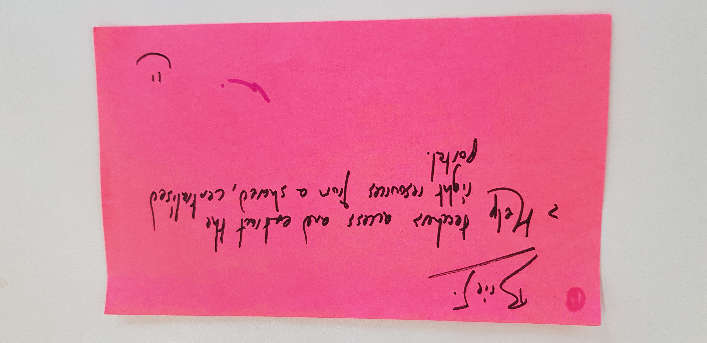
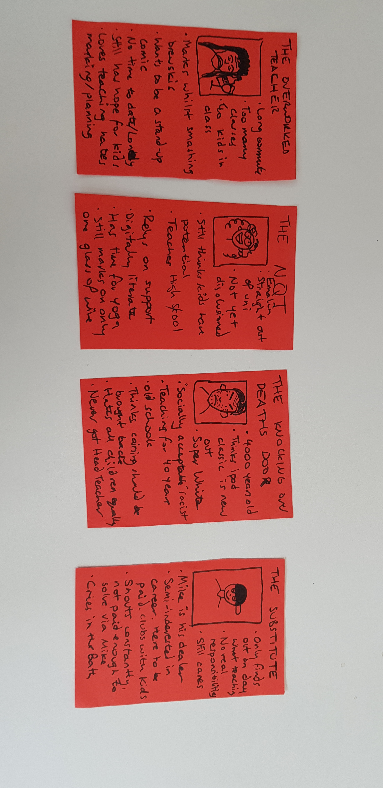
Help teachers access and extract the right resources

Slide 26
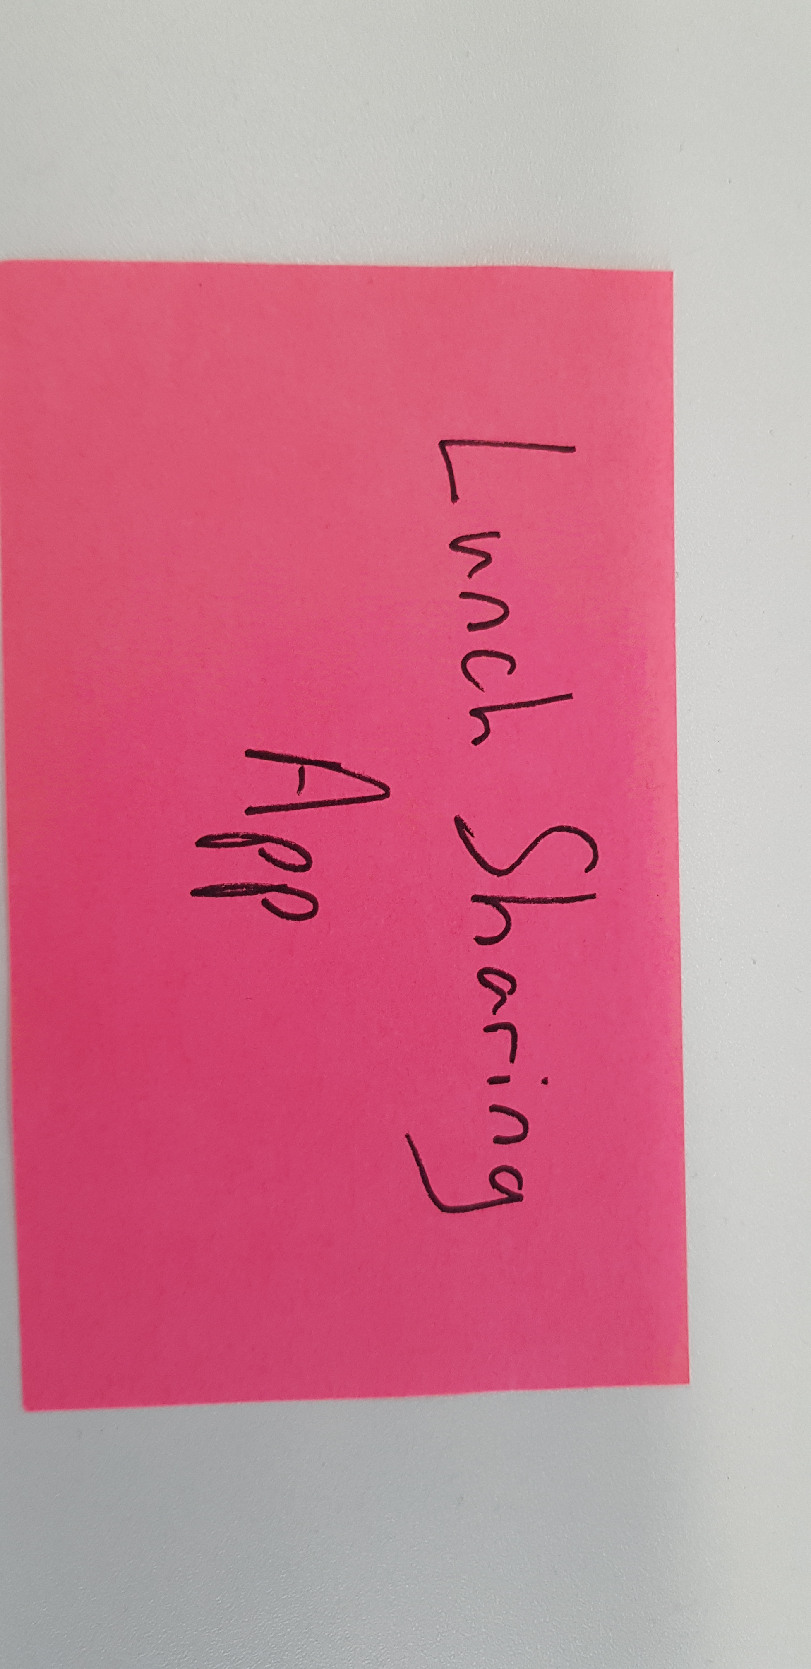
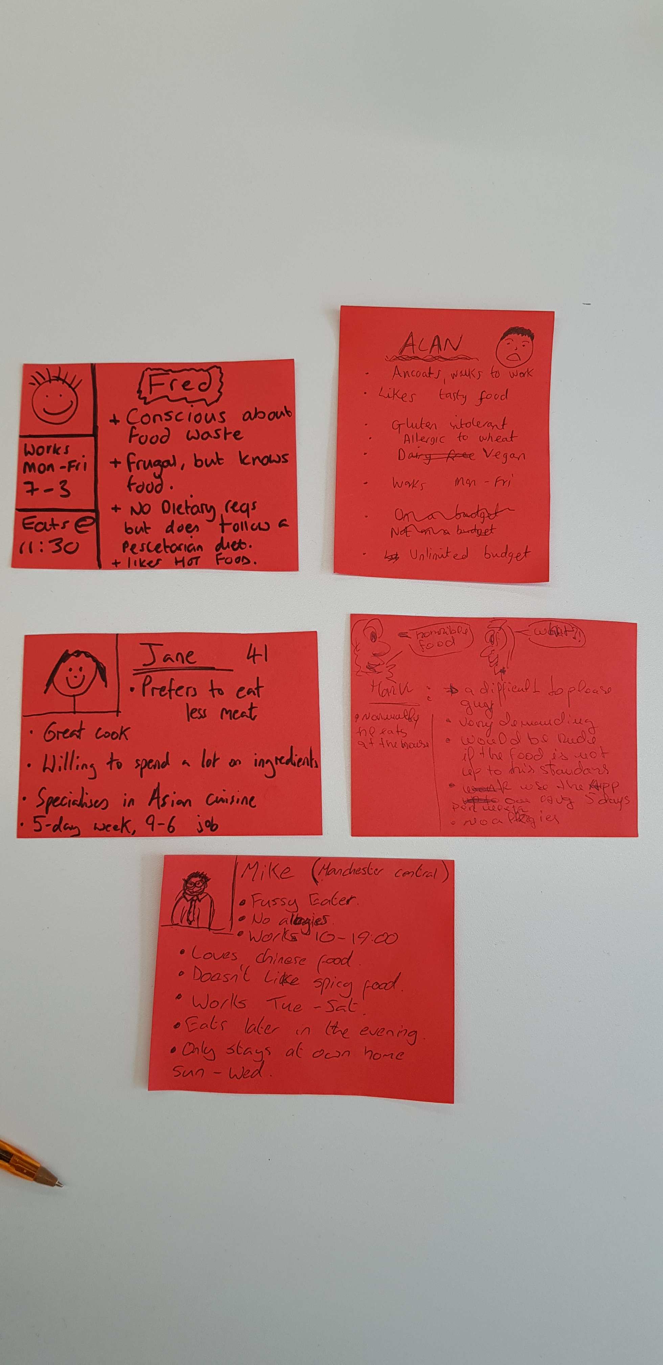
Lunch sharing app

Slide 27
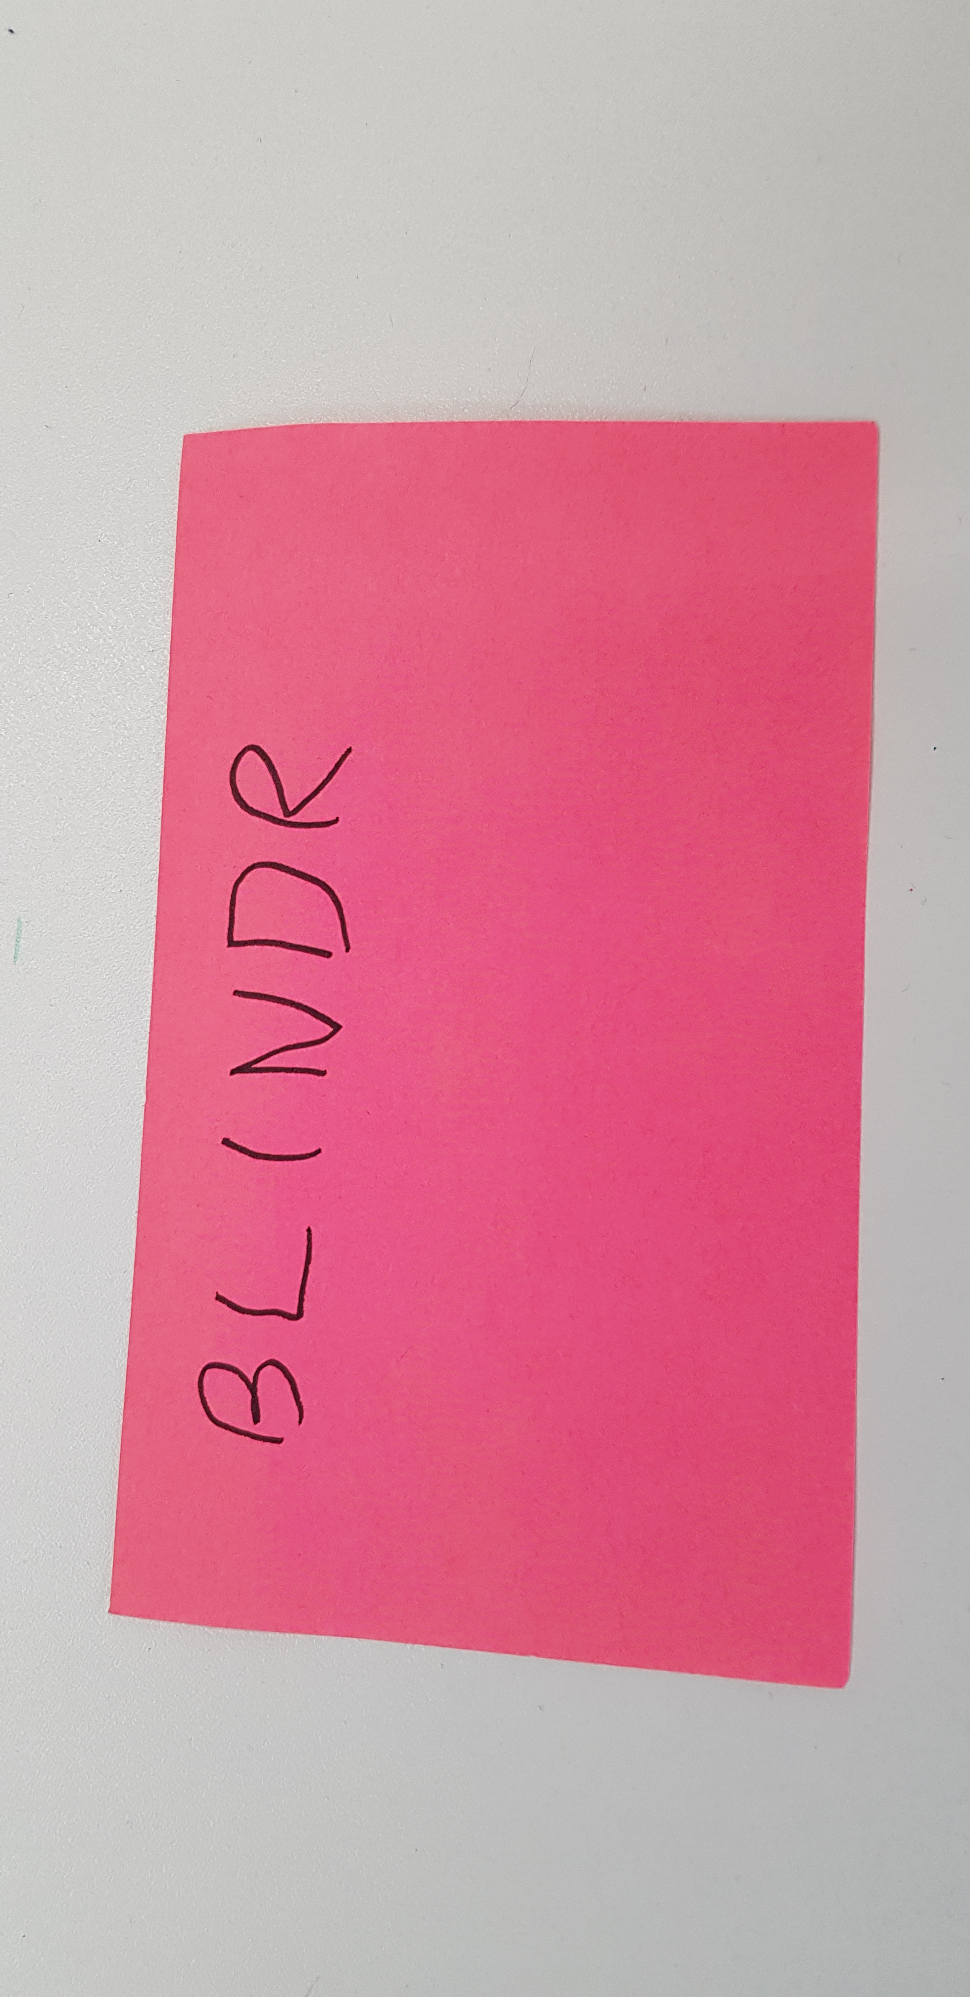
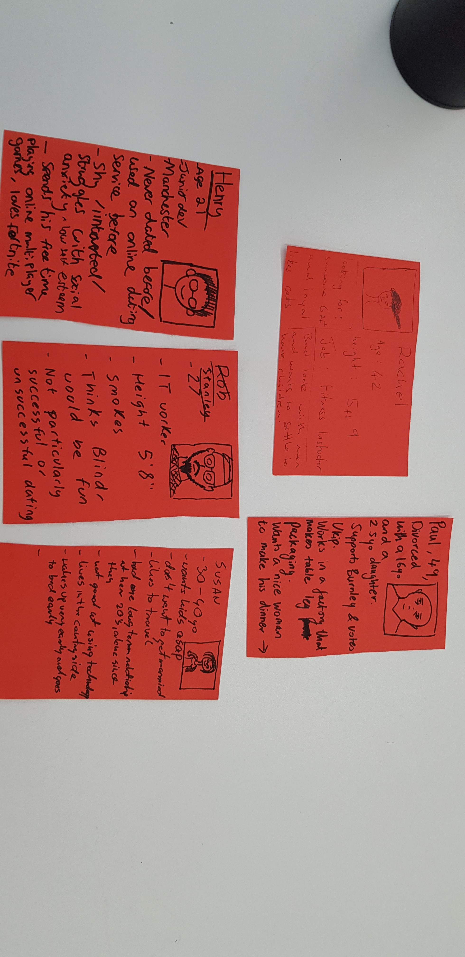
Blindr: Taking the fickle out of dating

Slide 28
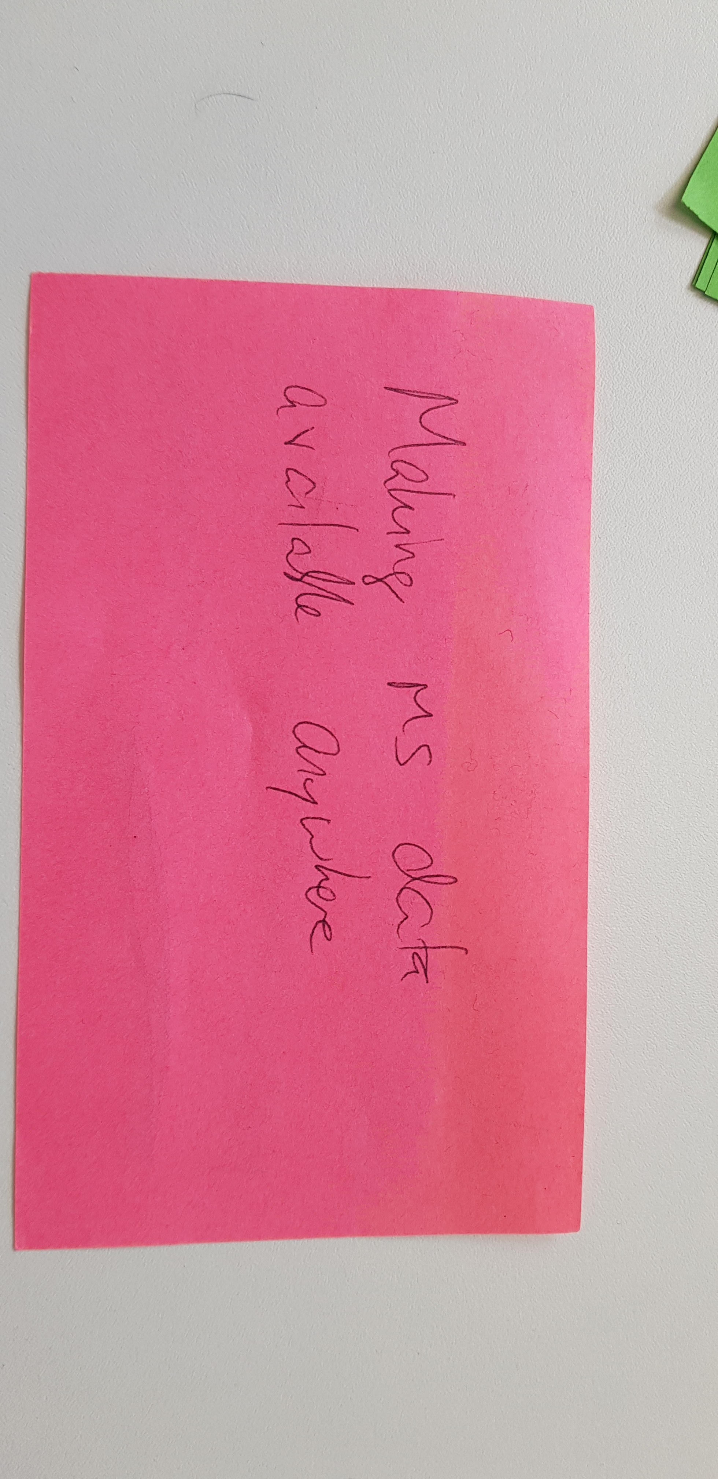
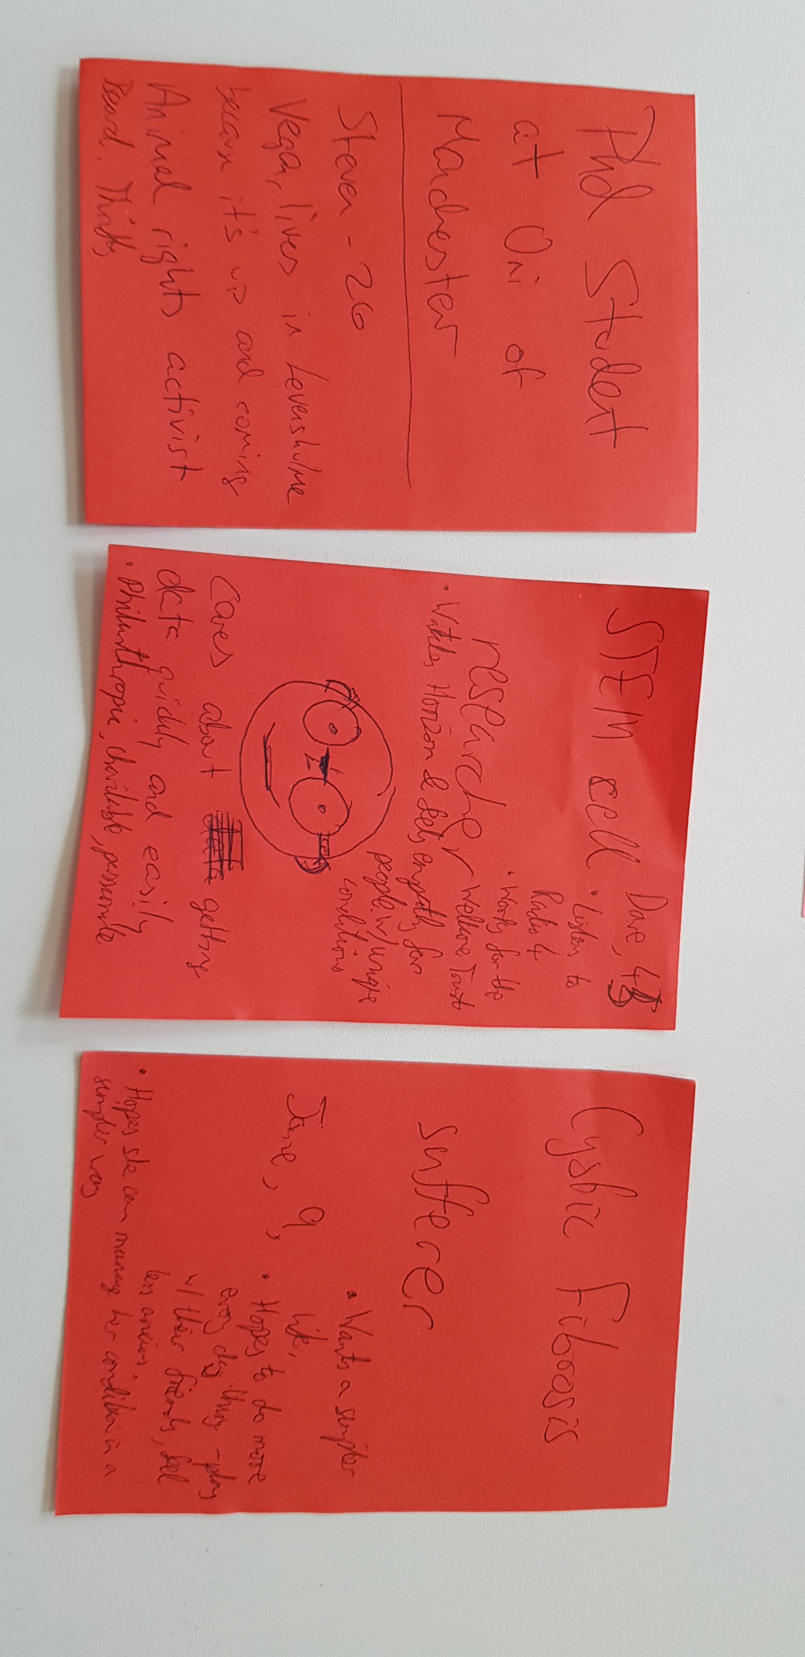
Making data available everywhere

Slide 29
Further Recommended Reading:
User Story Mapping by Jeff Patton
Sense and Respond by Jeff Gothelf
- case studies of lean start ups
#noestimates movement
https://engineering.rentalcars.com/physical-scrum-boards-not-waste-of-paper/ (agile taken into real life)

